Slide 1


Ontology Engineering
Assignment 4
Freek van Tienen, Hylke Visser & Herman Banken

Slide 2
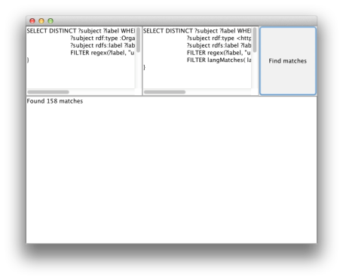
Matcher
Local en remote query
Zoekt op university naam

Slide 3
Matcher
Remote:
SELECT DISTINCT ?subject ?label WHERE {
?subject rdf:type <http://dbpedia.org/ontology/EducationalInstitution>.
?subject rdfs:label ?label.
FILTER regex(?label, "university" , "i").
FILTER langMatches( lang(?label), 'en')
}
Local:
SELECT DISTINCT ?subject ?label WHERE {
?subject rdf:type :Conferenceevent.
?subject rdfs:label ?label.
FILTER regex(?label, "university" , "i")
}

Slide 4
Query 1
Select all persons in the dogfood dataset that are affiliated with U.S. Universities that have more than 100 000 students
CONSTRUCT { ?university ?predicate ?object } WHERE {
?university rdf:type <http://dbpedia.org/ontology/EducationalInstitution>.
?university <http://dbpedia.org/ontology/country> <http://dbpedia.org/resource/United_States>.
?university <http://dbpedia.org/property/students> ?students.
FILTER ( ?students > 100000 ).
?university ?predicate ?object.
}
SELECT ?person
WHERE {
?university rdf:type <http://dbpedia.org/ontology/EducationalInstitution>.
?university <http://dbpedia.org/ontology/country> <http://dbpedia.org/resource/United_States>.
?university <http://dbpedia.org/property/students> ?students.
FILTER ( ?students > 100000 ).
?localuniversity skos:exactMatch ?university .
?person swrc:affiliation ?localuniversity
}

Slide 5
Query 2
Select all persons who work in different countries than the are based.
CONSTRUCT { ?university <http://dbpedia.org/property/country> ?country }
WHERE {
?university rdf:type <http://dbpedia.org/ontology/University>.
?university <http://dbpedia.org/property/country> ?country.
?university rdfs:label ?label.
FILTER regex(?label, "university" , "i")
}
SELECT DISTINCT ?person
WHERE {
?person swrc:affiliation ?localuniversity.
?localuniversity skos:exactMatch ?university.
?person foaf:based_near ?home.
?university <http://dbpedia.org/property/country> ?work.
FILTER( ?work != ?home).
}

